Slide 1
January 2018 Chemistry
Regents Exam
Detailed Answers

Slide 2
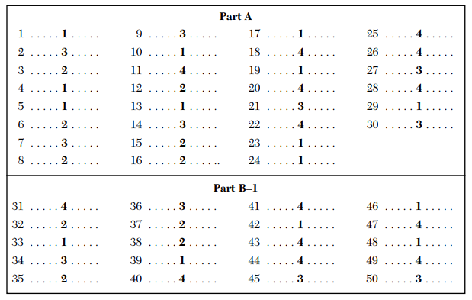

Slide 3
Protons and neutrons are in the nucleus, the electrons fly around outside the nucleus.
The old model of Dalton is called the billiard ball (hard sphere). Thompson came up with the plum pudding model with electrons buried in the “positive mush” of the atom – but this is NOT included. Next up was the Rutherford model of atoms with a positive nucleus with electrons flying around outside making the volume of the atom mostly empty space. Next was the Bohr model with electrons flying in orbits, or shells. Finally – but this too is not included in the answers, we have the modern model, AKA wave mechanical model, with electrons in orbitals, not orbits.
N, Ne, Mg, Si are nonmetal, noble gas, metal, and metalloid, in order.
Group 15 are N, P, and As, then Sb and Bi. All atoms in a group have the same number of valence electrons (outside orbital) and these all have 5 electrons (LOOK).

Slide 4
5. Ammonium sulfide has the NH₄⁺¹ cation and the S⁻² anion. Criss-cross the charges to get (NH₄)₂S which means two ammoniums for one sulfide.
6. Empirical formulas are really (dumb, I mean) math. Look for the MOST REDUCED, which is often not even a “real substance”. NH₃ cannot be reduced. The others all can be reduced.
7. Temperature and density are physical properties. Neutrons are alike, you can’t tell them apart. Chemical properties are used to tell the difference between substances that are chemically different, which is what differentiates compounds from each other.
Formula | Empirical formula
N₂O₄ | NO₂
C₃H₆ | CH₂
P₄O₁₀ | P₂O₅

Slide 5
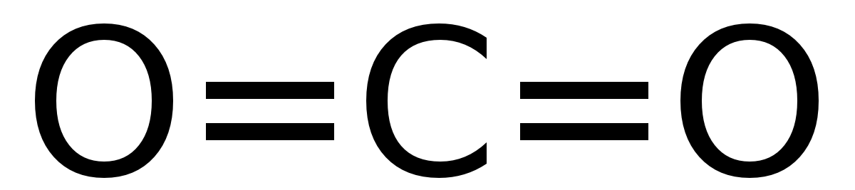
8. Ice is water, H₂O, is a molecular compound. It has no metals in it, so it’s not ionic (like NaCl). It happens to be homogenous (the same throughout) because it is a pure substance, but it’s NOT a mixture. It is neither heterogenous or a mixture.
9. CO₂ has TWO double polar covalent bonds, and is in a straight line shape, so it HAS radial symmetry. It is a NON POLAR MOLECULE and it has symmetrical distribution of charges – the both oxygens gain electrons from carbon because oxygen has a higher electronegativity. The oxygen atoms are NEGATIVE, the carbon atom is more POSITIVE. The radial symmetry keep the molecule nonpolar. 10. Elements that don’t react are NOBLE GASES. The noble gas here is helium

Slide 6
11. A classic question! When bonds form energy is released. Here 2 oxygen atoms (which are unstable alone) bond together (double nonpolar covalent bonds) and get more stable. Energy is released as bonds are formed.
12. Attracting electrons from other atoms is called electronegativity. It was described by Linus Pauling. No difference in electronegativity values means a nonpolar bond. The greater the difference, the greater the bond polarity. Fluorine has the highest electronegativity value of 4.0, and this is both an arbitrary scale (the numbers don’t matter, they just rank), and it’s also a relative scale, all atoms measured RELATIVE to one atom (F).
All copper has the same density (it’s a constant for each substance. All copper has the same chemical properties (they all bond in the same way).
Only elements cannot be broken down by chemical change, so choose TUNGSTEN or W.

Slide 7
The KMT is a theory that explains how gases can exist, and how they remain gases. Of these choices, only: ideal gases are in random, constant, straight line motion is correct. Without transferring energy means the collisions are not elastic. Regular geometric patterns is a solid. Small distances are liquids or solids, gas particles are really far apart.
Ah! The Avogadro’s Hypothesis question. Grunt out tons of mole math, or remember this: Equal volumes of different gases, at the same temperature and pressure, have the same number of moles, and particles. So, 6 liters of Cl_{2(G)} at STP has the same number of molecules as 6 liters of any other gas in the world at STP.
Just like falling in love, the reaction can’t happen unless you have collisions with sufficient energy and proper orientation.
Potential energy diagrams show the FLOW of ENERGY in a chemical reaction over time.

Slide 8
19. Catalysts do not affect the collision rate. Rather they LOWER ACTIVATION ENERGY or they OFFER AN ALTERNATE PATHWAY for the reaction to proceed (quicker).
ALKYNES are on table Q. LOOK at it now, so you know what you have there. It’s C_{n}H_{2n-2}
Electrons being transferred can only be the formation of ions (which is NOT a choice) or OXIDTION – REDUCTION (Redox). Electrochemistry.
22. Anodes… think this instead: LEO is a RED CAT (which stands for reduction happens at the cathode. So, anodes do the other thing, oxidation occurs at the anode.
23. Voltaic cells are batteries, chemistry makes electricity. They don’t need electricity, they make it. Electrolytic cells require electricity to force redox (electroplating).

Slide 9
Arrhenius acids are listed on table K, LOOK NOW. Arrhenius acids release hydrogen ions in solution, the more H⁺¹, the more acidic they are. HBr is not on the list, but it is similar to HCl. NaBr is not an acid. NaOH and NH₃ are both bases (table L).
You did this lab during acid-base, it’s called Acid-Base Titration. Remember how the base made the solution hot pink! It was phenolphthalein (table M)
This is classic acid base neutralization: Acid + Base = Salt and Water
This is that “stupid” other theory called Bronsted Lowry. You have to remember this reaction: NH₃ + HOH → NH₄⁺¹ + OH⁻¹ which means ammonia and water make ammonium cation and hydroxide anions The Ammonia is the base because it ACCEPTS the hydrogen ion. The Water is the BASE because it DONATES the hydrogen ion. Acids “donate H⁺¹” in this dumb theory.

Slide 10
28. Changing from one atom to another is truly funky, and we only learned about this crazy stuff at the end of the year. It’s not even chemistry, it’s NUCLEAR CHEMISTRY. This is transmutation. Addition and substitution are organic reactions, reduction is redox.
An unstable nucleus can release a variety of radiation. Radiation is either pure energy (gamma radiation) or it’s in particle form, like alpha or beta, positrons, or protons or neutrons (look at table O now). It’s also called RADIOACTIVE DECAY.
Nuclear power plants, when working perfectly, produce little problems except for their long lasting radioactive wastes (which humans don’t know what to do with yet). If they break, which is almost to be expected, they can be really dangerous, releasing all sorts of toxic, radioactive wastes into the air and water and soil. That’s especially bad.

Slide 11
All atoms (or ions) that have 7 protons (positive) and 10 electrons (negative) have charge of -3. Neutrons never have charges, they are included to throw you off. ALL nitrogen anions have 7 protons and 10 electrons.
Excited states have electrons in higher than normal configurations. All atoms have GROUND STATE configurations on the periodic table. Compare these. An atom with 5 electrons (rhymes with Boron!) has a 2-3 (if you look). 2-2-1 means it’s excited.

Slide 12
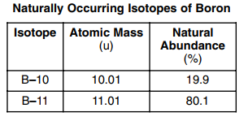
33. This is the trickiest question of them all! I hate it because it’s difficult just to be difficult. We’d do this this way: (10.01 amu)(.199) = 1.99199 PLUS (11.01 amu)(.801) = +8.87508
is: 10.86707 amu They screw around with the math here. It’s choice 1! They DID NOT change the percentages to decimals first. To accommodate this stupidity, they fool you by dividing the whole equation by 100. This makes the moth correct, but only crazy people do math this way.
34. Nonmetals are on the right side of the staircase (plus H). The atoms that gain 2 electrons to become anions (to become isoelectric to a noble gas) are O, S, and Se. They form O⁻², S⁻², and Se⁻² anions. They are ALL IN GROUP 16. Look at your periodic table now.

Slide 13
35. You could check each trend to figure this out. Make a chart. Or be lazy, and get it wrong. Don’t be lazy.
Choice 2, 1st Ionization energy decreases, is the only answer that is correct.
atom | Electronegativity values | 1st Ionization Energy | Valence electrons | Number of orbitals
F | 4.0 | 1681 kJ | 7 | 2
Cl | 3.2 | 1251 kJ | 7 | 3
Br | 3.0 | 1140 kJ | 7 | 4
I | 2.7 | 1008 kJ | 7 | 5
Group trend | decreasing | decreasing | constant | increasing

Slide 14
36. Do the math. First get the molar mass → KF K 1 x 39 = 39 g THEN… F 1 x 19 = 19 g 58 g/mole Do the conversion…. 37. Bond polarity is based on difference in electronegativity. The greater the difference, the more polar the bond. Make a chart (don’t be lazy). The greatest difference is with H – O
29 g KF 1
X = 0.50 moles KF (2 SF)
1 mole KF 58 g KF
choices | Atoms |  | difference
1 | C 2.6 | O 3.4 | 0.8
2 | H 2.2 | O 3.4 | 1.2
3 | N 3.0 | O 3.4 | 0.4
4 | S 2.6 | O 3.4 | 0.8

Slide 15
38. Table F shows us what ionic compounds are aqueous, or not aqueous (insoluble) in water. This is a sort of word game question, because AgCl is INSOLUBLE, (look at table F now) it does not ionize or dissociate in water. Fancy symbols aside, the “LOWEST” solubility is for our purposes NO SOLUBLITY. Hate them for this tricky question too.
Write the formula one more time. Do the math.
You have 2 samples of water, same size, one is colder (10°C) one is hotter (20°C) COMPARED TO SAMPLE 1, SAMPLE 2 CONTAINS… molecules with higher average kinetic energy, with higher average velocity, with MORE HEAT energy.
# of moles solute Liters of solution
0.500 moles 0.500 Liters
M = = = 1.00 M

Slide 16
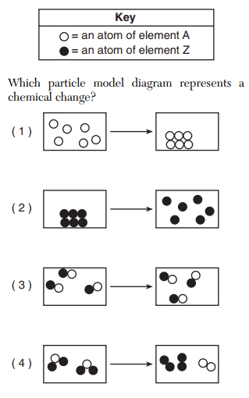
41. We love particle diagrams! Looking here for CHEMICAL CHANGE.
Choice 1 shows gas turning into a solid, which is deposition (opposite of sublimation. Choice 2 shows solid → gas, which is sublimation. Choice 3 shows nothing. You have 3 gas molecules at left, and the same three bas molecules at right. These could be CO_{(G)} or HCl _{(G)} Choice 4 shows 2 molecules becoming two different diatomic molecules. This is most likely 2 water molecules becoming 2 hydrogen molecules (black dots = H) and one oxygen molecule (white dots = O)

Slide 17
42. Look at table H, but first look at table K (acids) Find that formula, which is CH₃COOH, which is the organic formula for acetic acid. You might call it ethanoic acid too.
Find 90C, and you will see clearly it has to be 40 kPa. Another tricky thing with this table is… Temperature boxes = 5°C per box. kPa boxes go up by 10 kPa each box. Make sure you find the RIGHT point on the graph. Go look at this now, really. Don’t be lazy.
43. Orderly particles mean SOLID. Liquids have mobile particles (that are a little bit sticky but not stuck). Gases are just wild particles, random straight line motion, far apart, constantly moving, probably in Brooklyn by now!

Slide 18
44. The giveaway is the 101.3 kPa and 298 K. What is the title to table I? (look now!)
Find the reaction with C₃H_{6(G)} as the product, and find the ∆H : it’s -84.0 kJ/mole Ding ding: that reaction produces ONE mole of propene. This question says 2 MOLES. 84.0 x 2 = 168.0 kJ (they just said the heck with SF, it’s okay to hate them again!)
45. Isomers have the same chemical formula but are build different, they have a different structural shape. They also have different properties, they are NOT the same. Make a chart, don’t be lazy. COUNT THE ATOMS IN BLUE now.
 | Choices | Problems
1 | methanol & methanol | CH₃OH vs. CH₂O | X different formulas
2 | propanoic acid & pentanoic acid | 3 carbons vs. 5 carbons | X different number of atoms
3 | 1-propanol and 2-proponol | CH₂OHCH₂CH₃ and CH₃CH₂OHCH₃ | SAME EXACT ATOMS, different shape
4 | 1 chloropropane and 2 bromopropane | chlorine vs. bromine | X different halides

Slide 19
My favorite, this is how I made banana oil (the ester called methyl hexanoate) in college organic chem in Cortland!
Esterification is a reaction between an organic acid and an alcohol.
47. Potassium nitrate (KNO₃) is on table F. It’s ionic, and you see that it’s also aqueous. Ionic compounds that are aqueous dissociate, or ionize, and form loose, mobile ions in solution. They conduct electricity, which is the definition of electrolyte. KNO_{3(S)} → K⁺¹_{(AQ)} + NO₃⁻¹_{(AQ)}
48. The pH scale is a log scale (exponent scale) and each whole number change = a 10X change. It runs 0 – 14. Lower numbers, below 7, are acids. If the acid pH changes by a whole number (lower) it is now 10X more acidic. If the acid pH changes by a whole number (higher) it is not 10X less acidic. Here, the acid ions decrease by a factor of 10, the pH must increase by 1

Slide 20
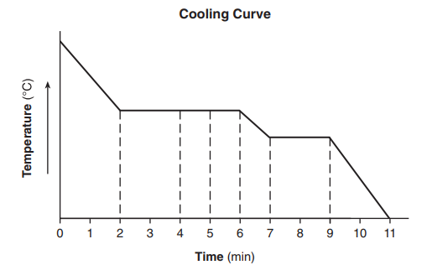
49. On this cooling curve, the top (hottest) part of the graph is steam, and the bottom right is solid ice. I labeled points for you. Correlate them with the time, and you are done.
A-B is only gas B-C is the phase change G→L condensing C-D is cooling liquid only D-E is the phase change L→S freezing E-F is cooling ice solid only
A
B
C
D
E
F
Liquid to solid is only from D to E, or 7 to 9 minutes. Choice 4

Slide 21
50. This is the combustion of methane, and it’s exothermic too. It’s reactants are methane and oxygen, to make more effective collisions you can increase their temperature (not a choice) increase their surface area (doesn’t actually apply to gases) or you could increase their concentration (which is correct). You might try a catalyst to speed it up, but that DOES NOT impact collisions.
Reactants → Products

Slide 22
51. Convert melting point of mercury to Celsius. Look up the temperature on table S, it’s 234 Kelvin. Write the formula, do the math: K = C + 273 → 234 K = C + 273 → C = -39.0°C
52. Lewis dot diagram for hydrogen MONOfluoride (HF) H has one dot (1 electron), F has 7 dots total. Combined, F gets the octet. Not ionic, no brackets here.
53. Numerical setup (don’t solve but you could) q = mH_{V} = (102.3 g)(2260 J/g)

Slide 23
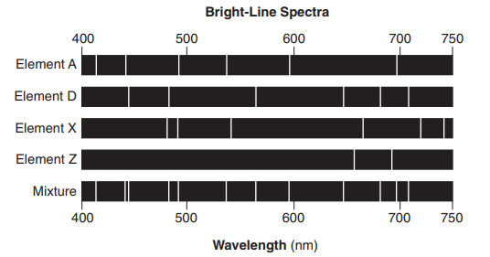
Acid base Chem, Table M. This solution, 0.10 M NH3 is a weak base, which would have a pH of more than 7, but probably less than 9. All solutions with pH over 4.4 in methyl orange turn yellow.
It’s A and D. Look at this picture now. The mixture, at the bottom, contains lots of stuff. Some could be A, D X, Z, or other stuff. We don’t know, but we can match up the choices with the mixture. A and D are there.

Slide 24
In terms of electrons AND energy states, how light emitted by excited atoms is produced.
Atoms have electrons in the ground state (lowest energy levels) normally.
When they get energized, the electrons can absorb specific amounts of energy and jump up to higher than normal electron orbitals. This is the excited state.
When these electrons emit that newly absorbed energy, that is the spectra. When they emit that energy, they can go back to the ground state orbitals or energy levels they normally live in.
Spectra is EMITTED when energy is released.

Slide 25
57. This is hardly chemistry, it’s reading the table, and knowing the difference between physical and chemical properties. State a chemical property of IODINE. The correct choices include: - forms ionic bonds with active metals or forms ionic bonds or reacts with metals
Look at periodic table now: Ground state Rb is 2-8-18-18-1 Ground state I is 2-8-18-18-7 Write: Rb has an atomic radius of 215 pm while I has an atomic radius of 136 pm
Electrical conductivity is based (mostly) on whether or not the elements are metals or not. Metals conduct electricity while non metals don’t. Rubidium is a metal, it conducts electricity well. Iodine is a nonmetal solid, it does not conduct electricity at all.

Slide 26
60. Balance this equation: In the answer booklet it looks like this: ____P_{4(S)} + ____Cl_{2(G)} → ____PCl_{3(L)} + energy If you need a “1”, you can leave it out, or write in a “1”, both are OK here. The answer is: 1 P_{4(S)} + 6 Cl_{2(G)} → 4 PCl_{3(L)} + energy or: P_{4(S)} + 6 Cl_{2(G)} → 4 PCl_{3(L)} + energy
61. Explain why this is synthesis: Write: two elements combine to form one compound, or two reactants form into one product, or two substances react to form one product

Slide 27
62. Numerical setup for the percent composition by mass of PCl₃ You could solve it too. PCl₃ P 1 x 32 = 31 g P X 100% = 23.4 % Cl 3 x 35 = 105 g 136 g/mole Cl X 100% = 76.6% 100% Only the RED is required for a point, you should do all the work to be sure. 63. Nuclear Chem! In Terms Of Neutrons and Protons: Why are U-238 and U-234 different isotopes of uranium? Both of these atoms are uranium, but with different masses. All uranium atoms have 92 protons (they are #92 on the periodic table). The masses are the sum total of protons + neutrons. They have different numbers of neutrons. U-238 has 92 protons and 146 neutrons (92 + 146 = 238) U-234 has 92 protons and just 142 neutrons (92 + 142 = 234)
32 136
105 136

Slide 28
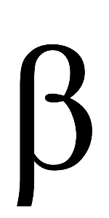
Decay particles (see table O for some help. Th-234 decays (emits radioactivity and changes into a different kind of atom) Wow (yes, wow). Do the simple math, the top numbers and then the bottom numbers. Solve for the missing part. The arrow is an = sign. The “math” across the top is 234 = X + 234 X = 0 The “math” across the bottom is 90 = X + 91 X = -1 The particle on table O that we are seeking has no mass (top number) and a -1 charge (bottom number, which can only be a BETA PARTICLE which looks like this:
234 90
Th X +
Pa
234 91
0 -1
e or

Slide 29
65. Half life problems require you to draw a t-chart, or else you will probably get it wrong. WHOLE HALF QUARTER EIGHTH SIXTEENTH Time 0 1 Half Life 2 HL 3 HL 4 HL
To have only one-sixteenth the starting mass, you must pass four half life times. For this stuff, T-234, the half life given as 24.10 days. Do the math: 4 X 24.10 days = 96.40 days. 66. Empirical formulas (dumb!) C₂Cl₄ is the compound formula, the empirical formula is: CCl₂

Slide 30
2NaHCO_{3(S)} + heat → Na₂CO_{3(S)} + H₂0_{(L)} + CO_{2(G)} 67. The polyatomic ion in the solid product is the CO₃⁻² anion, called carbonate anion.
68. Heat flow between air in the oven, and the batter: Air in oven is much hotter, heat flows from hot to cold (cold is just the lack of heat). Heat flows from air to batter. 69. Liquid water Potential Energy vs. Steam water Potential Energy. Liquid water has lower potential energy than the steam does.

Slide 31
Significant figures in pressure at surface of lake 104.0 kPa is 4 SF
Calculate volume of bubble at bottom of lake… Start with combined gas law, then fill in the blanks. Use your units!
Mass of air bubble at surface: use density formula
P₁ V₁ T₁
P₂ V₂ T₂
(618.3 kPa)(V₁) 282 K
=
(104.0 kPa)(2.5 mL) 293 K
=
D =
Mass Volume
0.0012 g/mL 1
Mass 2.5 mL
Mass = 0.0012 g/mL X 2.5 mL =
Mass = 0.0030 grams or 3 x 10⁻³ g
=

Slide 32
73. State evidence that the forward reaction is exothermic. Energy is a product in the forward reaction, that is exothermic.
74. Compare rates of forward/reverse reactions. In dynamic equilibrium, the rate of the forward reaction = the rate of the reverse.
75. What stress makes more brown gas (makes a reverse shift)? Decrease pressure, add energy, add heat, increase temperature, or increase volume of the container (which lowers pressure).

Slide 33
76. Compare the intermolecular forces in the NO₂ and the N₂? NO₂ is a polar molecule, it has dipole attractions. They are stronger than the electron dispersion forces that the N₂ has. NO₂ has stronger IMF than N₂.
77. Oxidation state of the N in NO₂. This molecule must have oxidation numbers that sum to zero. Both oxygen atoms have a -2 oxidation number, while nitrogen has many oxidation numbers to choose from, do the “math” X + -4 = 0 the X for nitrogen would be +4

Slide 34
78. Moles of Mg⁺² ions produced when 2.5 moles of Zn⁺² react. This is redox (electrochem) From the equation provided, it should be clear that for every Zn⁺² reacting, you get one Mg⁺². Therefore if 2.5 moles of Zn⁺² react, then you get 2.5 moles of Mg⁺² forming.
79. The porous barrier is the “salt bridge”, which allows the flow of ions between the half cells. That keeps the solutions neutral and the battery (voltaic cell) able to continue. 80. The Mg is more reactive than the Zn (see table J). You might say the Zn is less active than the Mg, or even get away with Mg is higher on table J than the Zn. 81. Write the balanced half reaction for oxidation in this cell: Mg° → Mg⁺² + 2e⁻

Slide 35
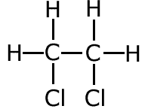
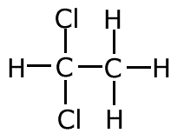
82. Why is the hydrocarbon in equation 1 unsaturated? C₂H₄ + Cl₂ → C₂H₄Cl₂ The C₂H₄ is unsaturated because it’s an alkene (see table O), or there is a double bond between the two carbon atoms which means they could hold more hydrogen atoms – if single bonded, as the alkane C₂H₆ does. 83. The product in this reaction is C₂H₄Cl₂ This is classified as a halocarbon or a halide. Possibly you could get away with haloalkane. 84. Structural diagram for C₂H₄Cl₂ or 85. The vinyl chloride monomer has a double bond between the carbon atoms. The two carbon atoms share 4 electrons. If you say 2 pairs it is less good. Answer the question that they ask you.

